Slide 1

PSALM 84

Slide 2
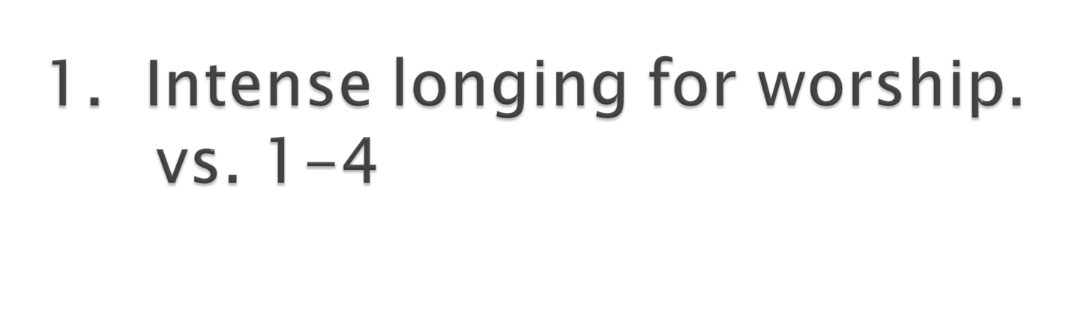

Slide 3
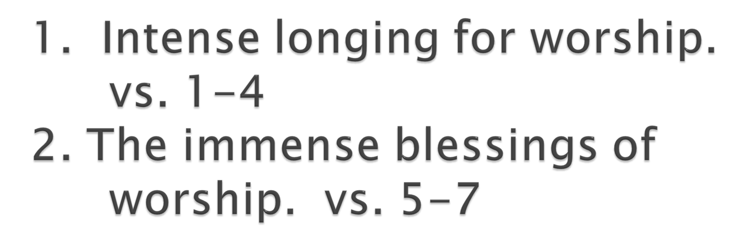

Slide 4
Strength vs. 7

Slide 5
Strength vs. 7
Satisfaction vs. 8-12

Slide 6
Strength vs. 7
Satisfaction vs. 8-12
    “Better is one day in your courts than a thousand elsewhere; I would rather be a doorkeeper in the house of my God than dwell in the tents of the wicked.” vs.10

Slide 7
Satisfaction in having the light of God shining on our pathway and having the shield of God to protect us from evil.

Slide 8
Satisfaction in having the light of God shining on our pathway and having the shield of God to protect us from evil.
Satisfaction in receiving grace for living and glory for the future.

Slide 9
Satisfaction in having the light of God shining on our pathway and having the shield of God to protect us from evil.
Satisfaction in receiving grace for living and glory for the future.
Satisfaction in knowing God will not withhold from those who truly worship him anything they need.

